Slide 1

Scheduling

Slide 2
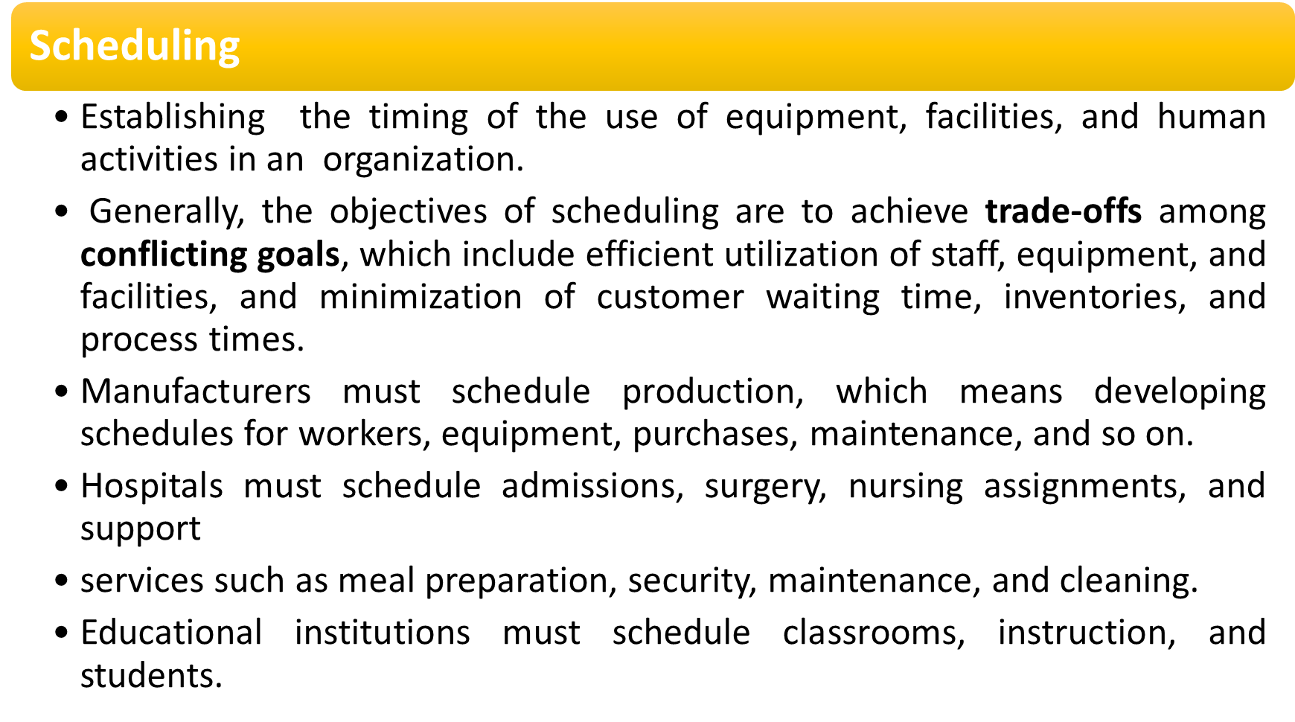

Slide 3
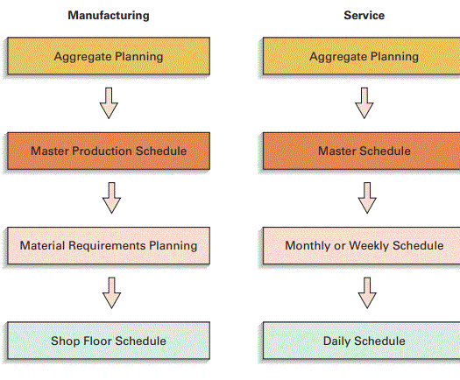
Fig: Scheduling Hierarchies

Slide 4
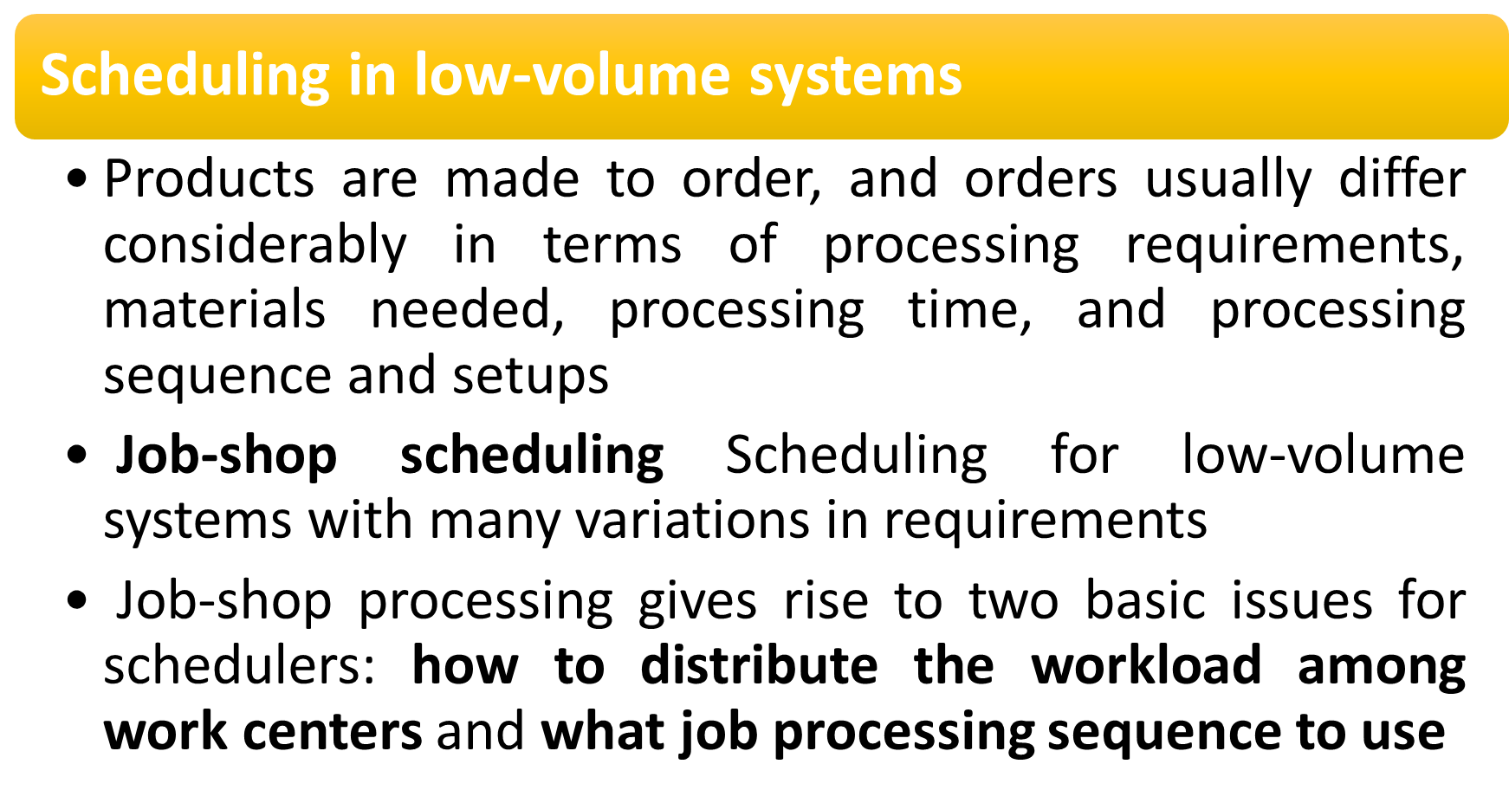

Slide 5
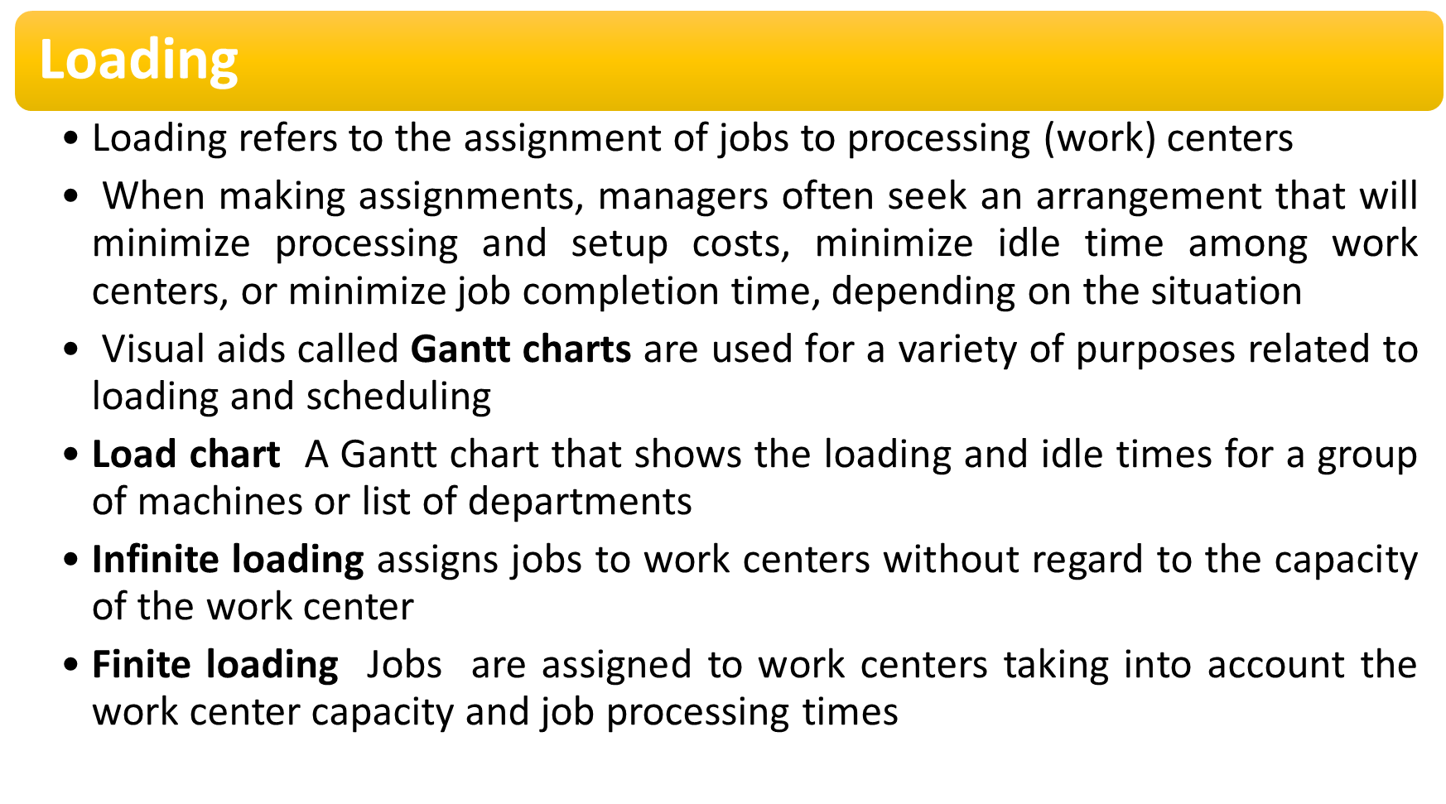

Slide 6
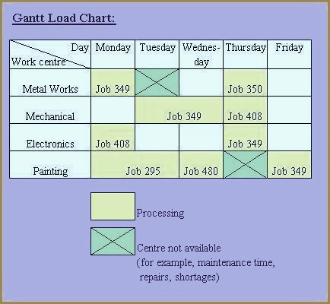
Load chart A Gantt chart that shows the loading and idle times for a group of machines or list of departments
Infinite loading assigns jobs to work centers without regard to the capacity of the work center
Finite loading Jobs are assigned to work centers taking into account the work center capacity and job processing times

Slide 7
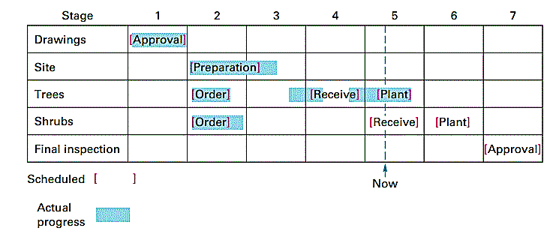
Schedule chart A Gantt chart that shows the orders or jobs in progress and whether they are on schedule
The vertical axis on this type of Gantt chart shows the orders or jobs in progress and the horizontal axis shows time.
The chart indicates which jobs are on schedule and which are behind or ahead

Slide 8
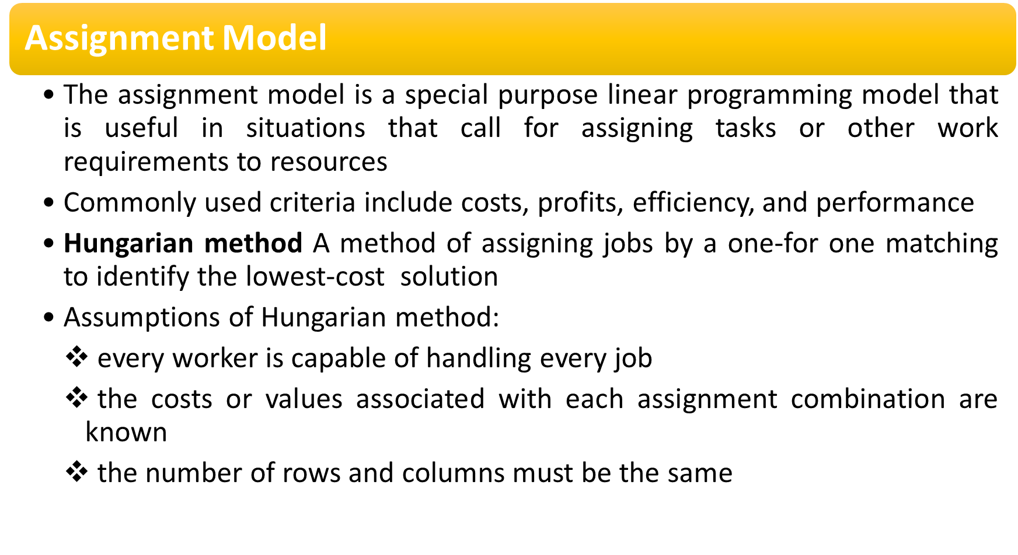

Slide 9
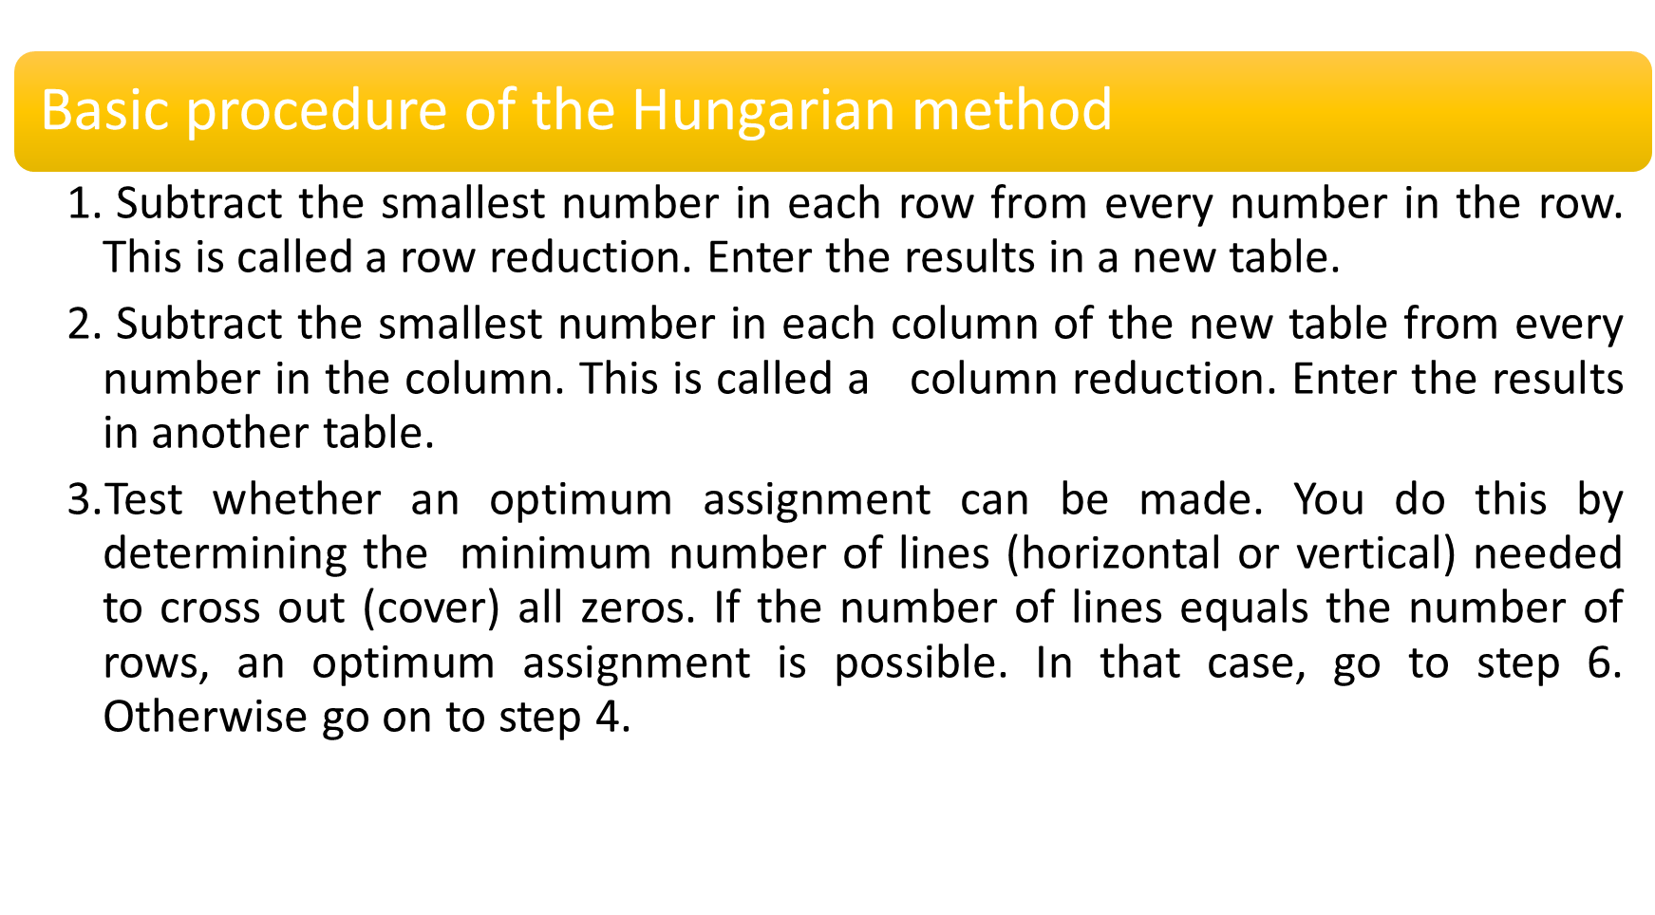

Slide 10
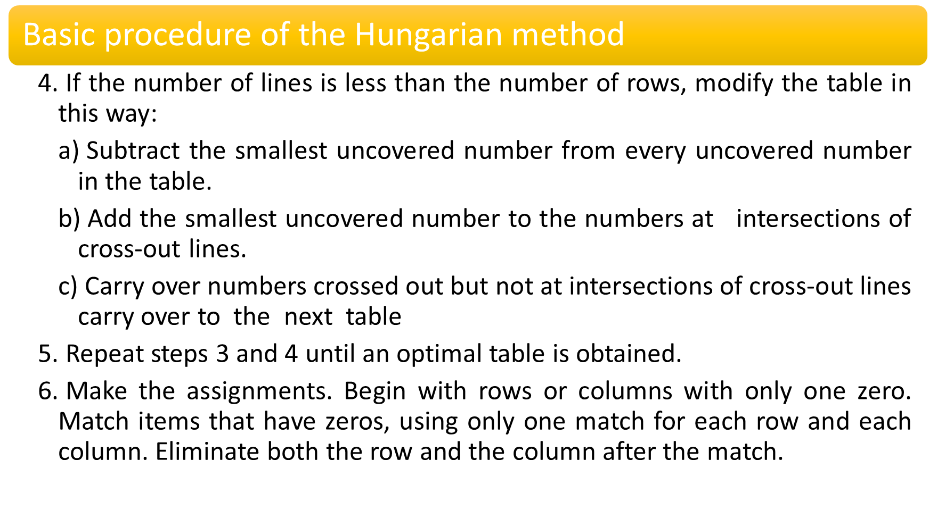

Slide 11
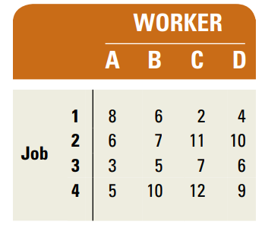
The following table contains information on the cost to run four jobs on four available workers. Determine an assignment plan that will minimize costs.

Slide 12
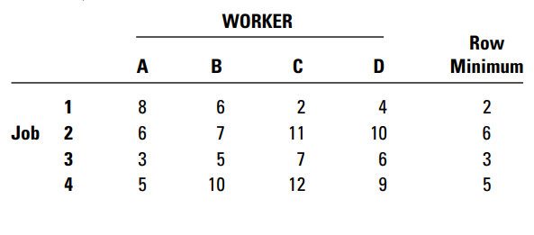

Slide 13
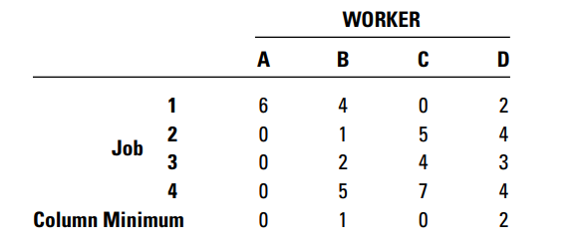

Slide 14
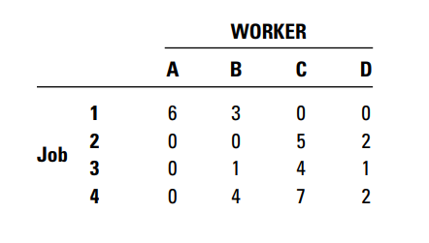

Slide 15
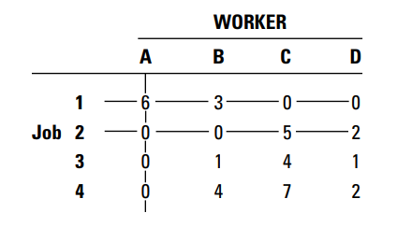

Slide 16
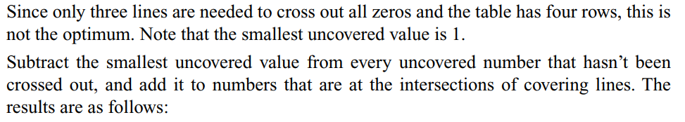
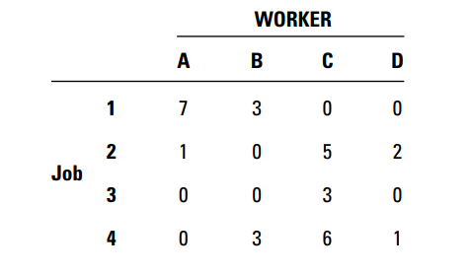

Slide 17
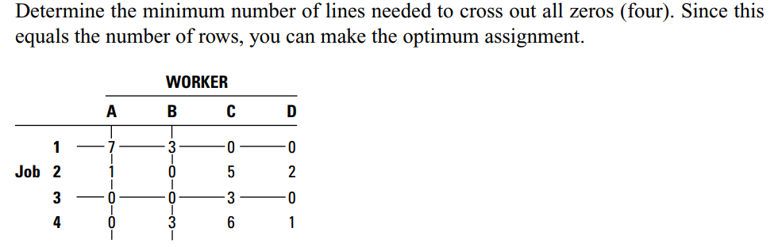

Slide 18
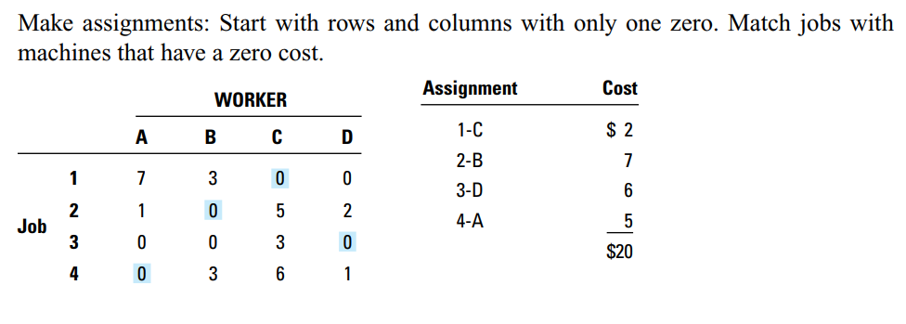

Slide 19
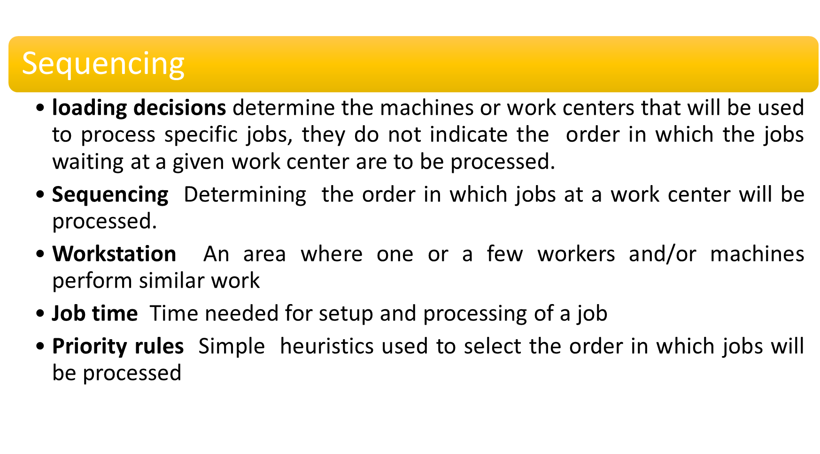

Slide 20
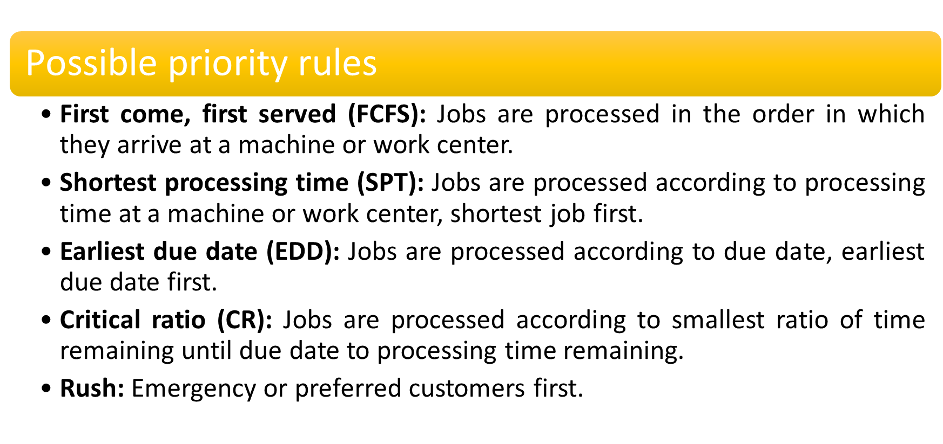

Slide 21
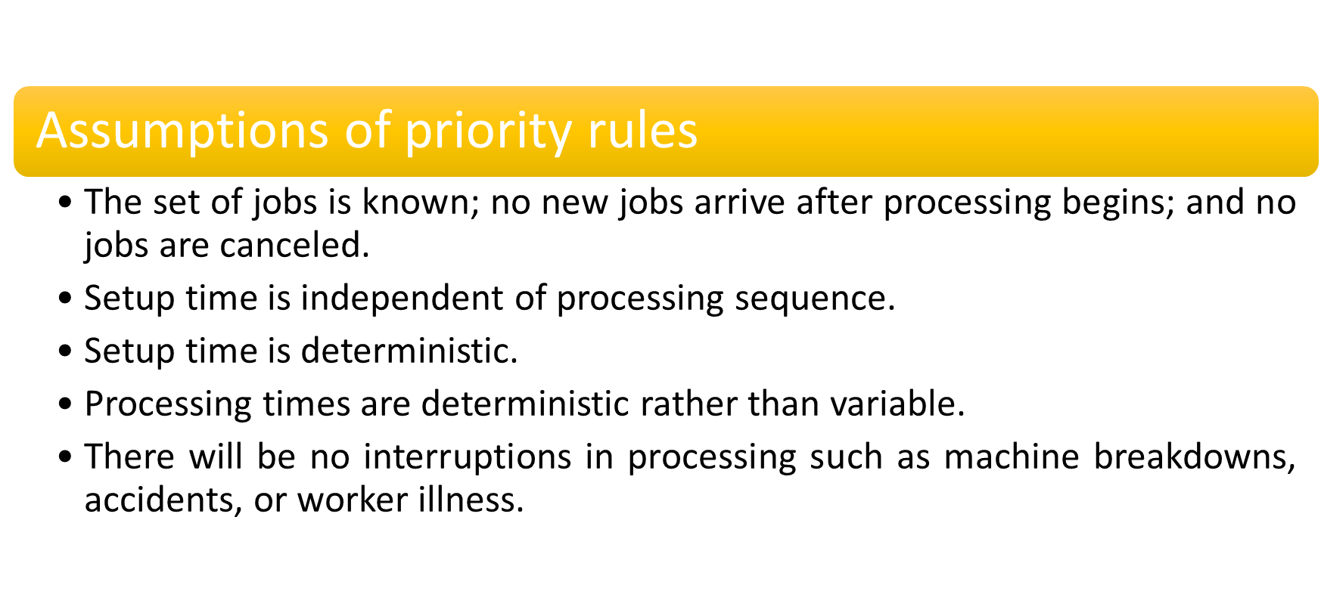

Slide 22
The effectiveness of any given sequence is frequently judged in terms of one or more performance measures. The most frequently used performance measures follow:
>> Job flow time The amount of time from when a job arrives until it is finished.
>> The average flow time for a group of jobs is equal to the total flow time for the jobs divided by the number
of jobs.
>> Job lateness The difference between the actual completion date and the due date.
If only differences for jobs with completion times that exceed due dates are recorded, and zeros are assigned to jobs that are early, the term used is job tardiness.
>> Makespan Total time needed to complete a group of jobs from the beginning of the first job to the completion of the last job
>> The average work-in-process for a group of jobs can be computed using the following formula:
Average number of jobs = Total flow time / Makespan

Slide 23
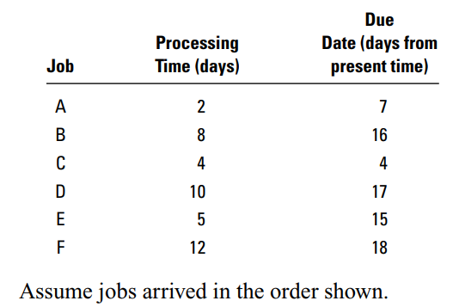
Processing times (including setup times) and due dates for six jobs waiting to be processed at a work center are given in the following table. Determine the sequence of jobs, the average flow time, average tardiness, and average number of jobs at the work center, for each of these rules:
FCFS
SPT
EDD
CR

Slide 24
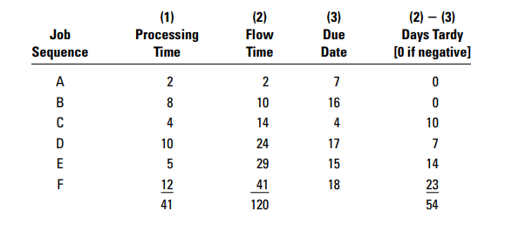
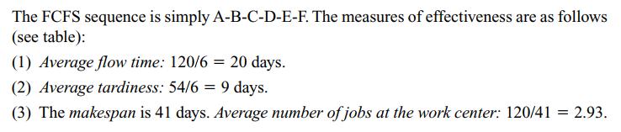
FCFS

Slide 25
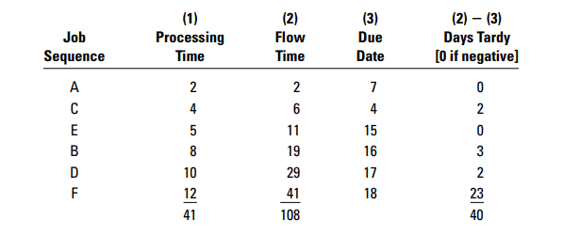
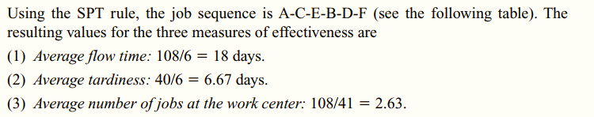
SPT

Slide 26
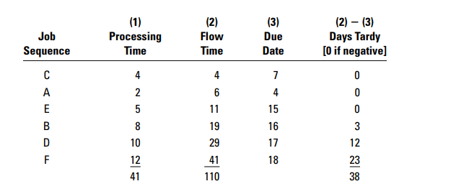
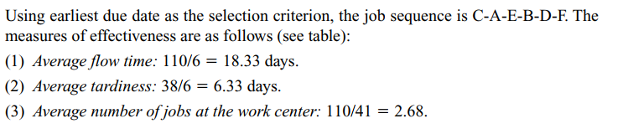
EDD
4
7

Slide 27
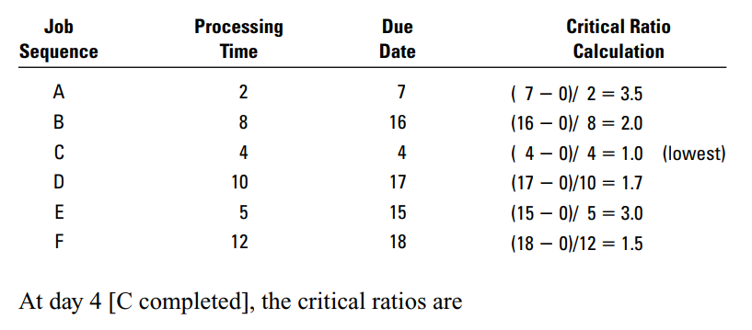
CR

Slide 28
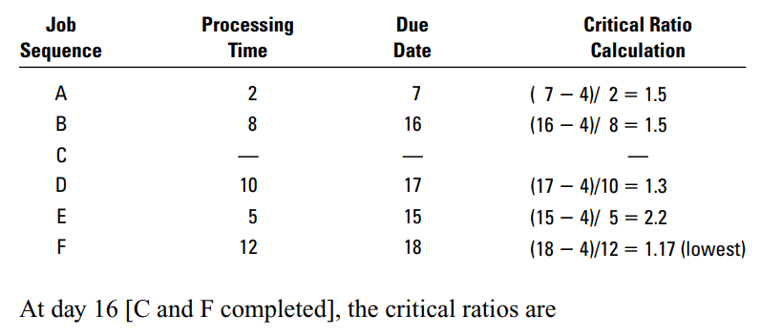

Slide 29
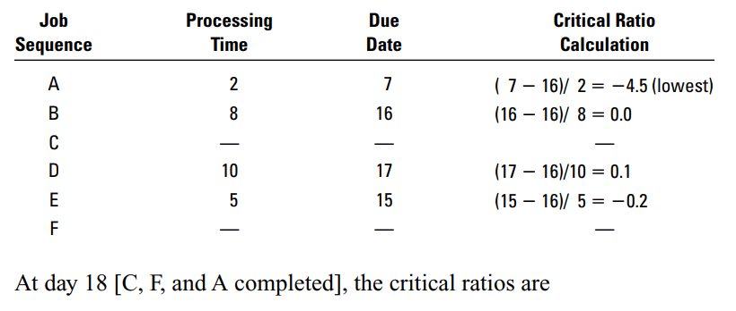

Slide 30
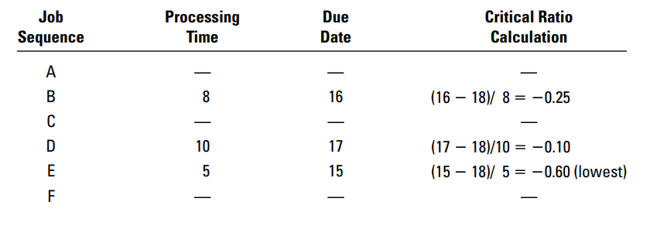

Slide 31
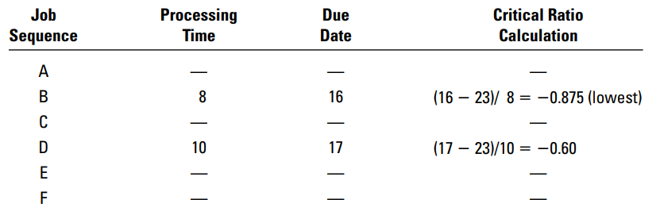
At day 31 [C, F, A, E and B completed]

Slide 32
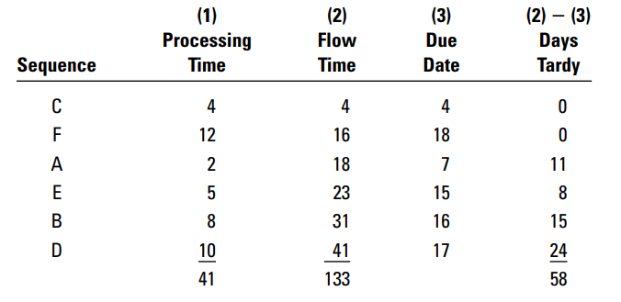
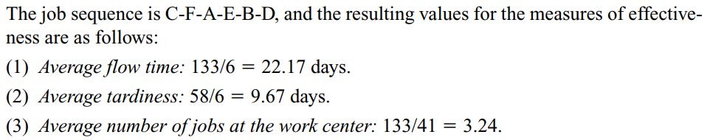

Slide 33
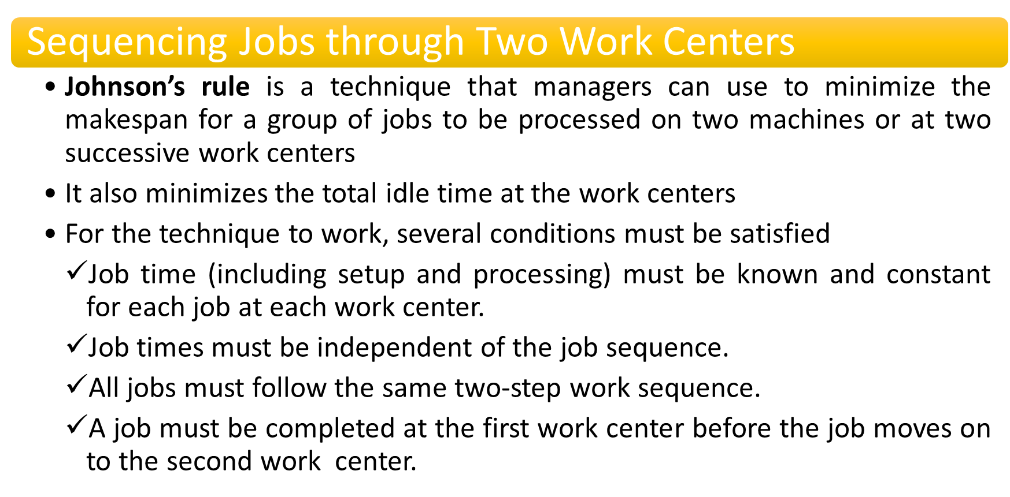

Slide 34
The sequence is determined by following these steps:
Select the job with the shortest time. If the shortest time is at the first work center, schedule that job first; if the time is at the second work center, schedule the job last. Break ties arbitrarily.
Eliminate the job and its time from further consideration.
Repeat steps 1 and 2, working toward the center of the sequence, until all jobs have been scheduled.

Slide 35
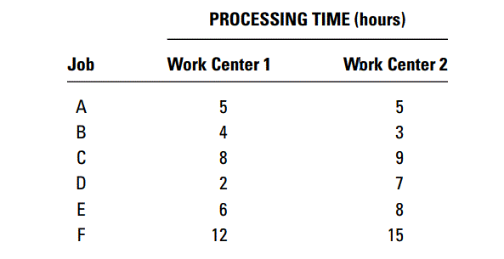
A group of six jobs is to be processed through a two-machine flow shop. The first operation involves cleaning and the second involves painting. Determine a sequence that will minimize the total completion time for this group of jobs. Processing times are as follows:

Slide 36
